Slide 1


Technical Report and Findings
The Lone Wolf
Module Leader: [REDACTED]
Digital Forensics and Incident Management
CST4230

Slide 2
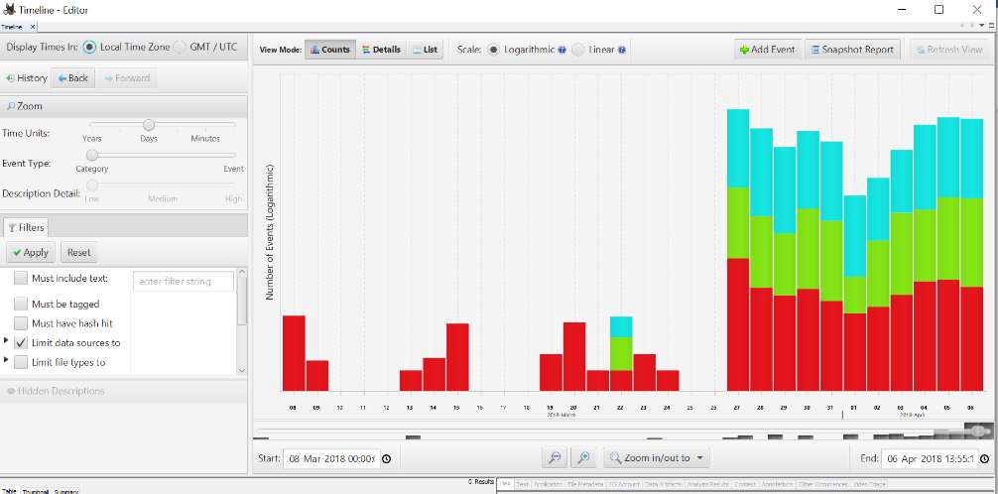
DEVICE ACTIVE PERIOD
Information is present on exhibit MDX/E1 to show that the computer has been active for the period 8th March 2018 00:00:00 hrs until 6th April 2018 1:55:14 hrs by the suspect, Lone Wolf.

Slide 3
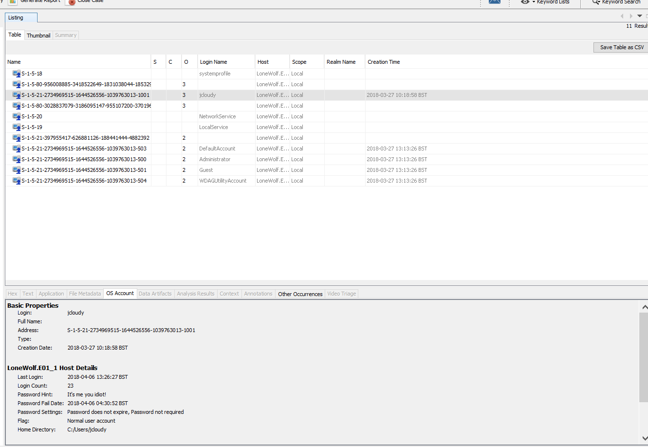
DEVICE LAST ACTIVITIES
Last login date and time
2018-04-06 13:26:27
The system has a password.
The last user was JCloudy.

Slide 4
BACKGROUND TO THE INVESTIGATION
The suspect, Lone Wolf, was arrested by the Police
The computer misuse act (1990), updated with the police and Justice act (2006) and search warrant
.
Association of Chief Police Officers (ACPO) guideline for computer-based evidence

Slide 5
LAPTOP SEIZURE AND IMAGING GENERATED
Laptop sized and imaged by Tom Moore on Friday, April 6 12:50:44 2018 using the ADI3.1.1.8 software
Investigating the contents using the Autopsy 4.19.3 software.
The Washington Police has requested that exhibit MDX/E1 is analysed for any evidence of mass shooting.

Slide 6
REMIT OF THE INVESTIGATION
Does the suspect have any intention and confession to commit the offence?
Does the suspect have any documented plan to commit the offence?
Does the suspect have plan to be at 21030 Whitfield Pl Sterling VA on 7th of April?
Does he have plan to travel out of the country on the same day?
Who else is aware of this plan?

Slide 7
Exhibit MDX/E1 Imaging details
Item | Description
Type | Laptop Computer
Make | Dell Inc
Model | Latitude E6430
Name | DESKTOP-PM6C56D
Processor | AMD64
Device ID | c9efaa8b-5b26-465f-a6f9-272fdbf8bcf8
System Date & Time | Fri Apr 6 12:50:44 2018
Accurate Date & Time | Fri Apr 6 12:50:44 2018

Slide 8
Exhibit MDX/E1 MD5 Hash
Exhibit Details of the MD5 hash
Hash Type | MD5 Hash | Note
Acquisition | 7af48fa65519e84246b1729e5b68f140 | Match
Verification | 7af48fa65519e84246b1729e5b68f140

Slide 9
Timeline of the events:
EVENT 1
Time: 03:16:48 BST
Date: 30/03/2018
A document named PLANNING was created that highlighted- Target, Supplies, Escape and Release.
EVENT 2
Time: 03:29:57 BST
Date: 30/03/2018
AIRPORT INFORMATION - 22 min to drive from Fairfax County Democratic Committee to Dulles Airport.
American Airline round trip itinerary from Washington DC to Denpasar Bali Indonesia and layover in Qatar from 7th April and return on 21st April 2018.
EVENT 3
Time: 02:35:27 BST
Date: 02/04/2018
CLOUDY MANIFESTO
Supporter of second amendment and ready to die
while defending it.
He named himself lone wolf who is ready to cause
collateral damage and shed blood of defenseless.
EVENT 4
Time: 05:56:19 BST
Date: 04/04/2018
OPERATION 2ND HAND SMOKE
about how lone wolf intended to carry out the likely mass shooting.
The venue is Democratic National Headquarter
Event - “Town hall for our lives”.
Google map Dulles Airport, to Indonesia on the same day and Sea Breeze Candidasa Hotel.
EVENT 5
Time: 03:39:29 BST
Date: 05/04/2018 to 06/04/2018
CLOUDY THOUGHTS (4TH)
Current status of the suspect’s mind.
He is nursing a fear of likely failure of his plans.
He has multiple cloud accounts where he saved his plans
He named Paul as someone who I guess is aware of all
these and has the only other keys.

Slide 10
EXHIBIT NUMBER AND DESCRIPTIONS
S/N | DESCRIPTIONS | NUMBER
1 | LONEWOLF’S FTK IMAGE FILES | MDX/E1
2 | PLANNING | MDX/E2
3 | AIRPORT INFORMATION | MDX/E3
4 | CLOUDY MANIFESTO | MDX/E4
5 | OPERATION 2ND HAND SMOKE | MDX/E5
6 | CLOUDY THOUGHTS (4TH) | MDX/E6
7 | CD-R | MDX/E7

Slide 11
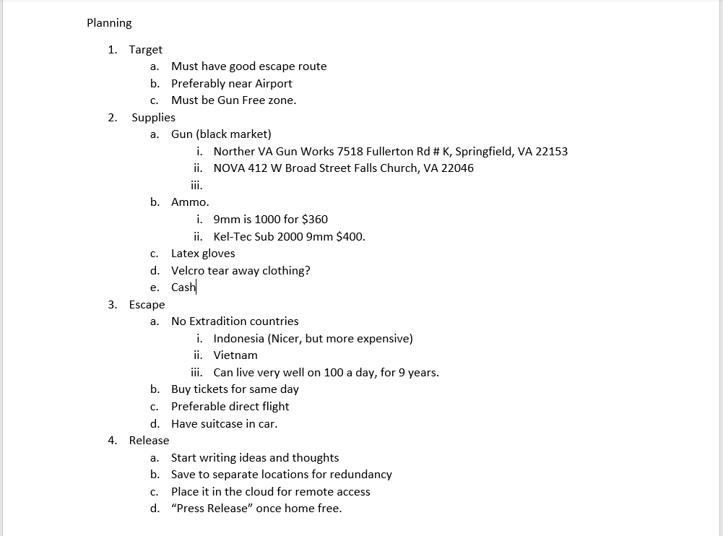
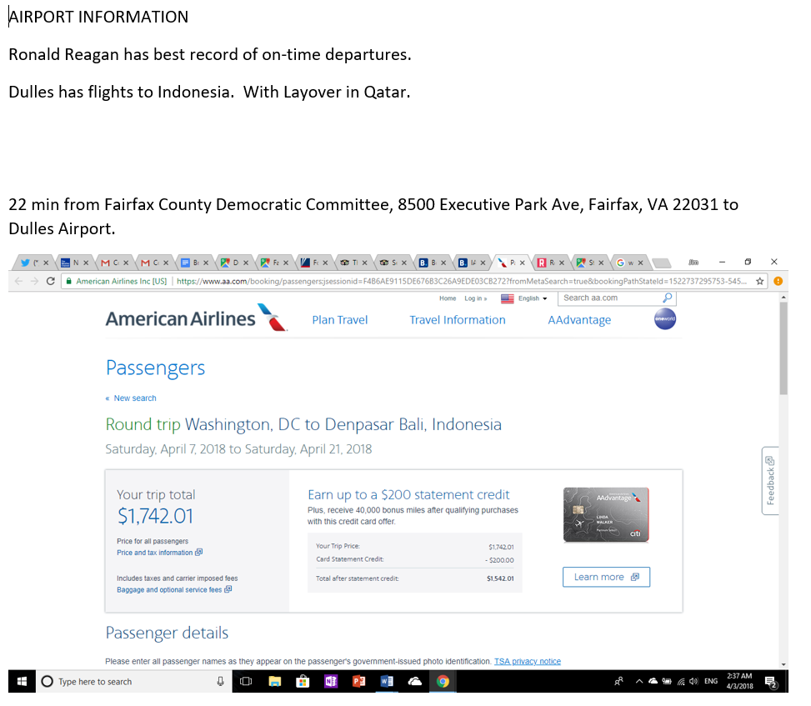
Presenting the Evidence: MDX/E2 &E3
Event number one and two:
The Document named Planning and Airport Information kick start this idea of possible mass shooting.
Target
Supplies
Escape
Release
Airport Information

Slide 12
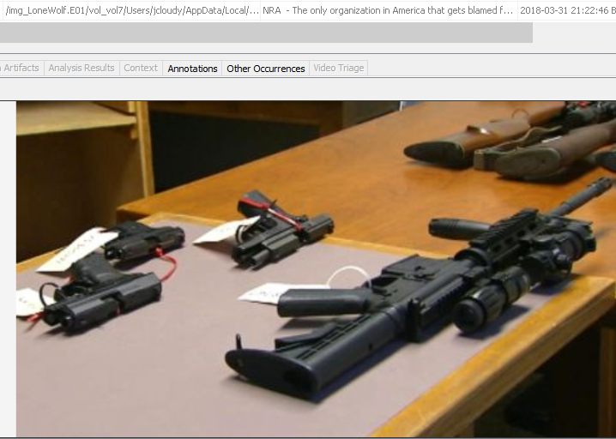
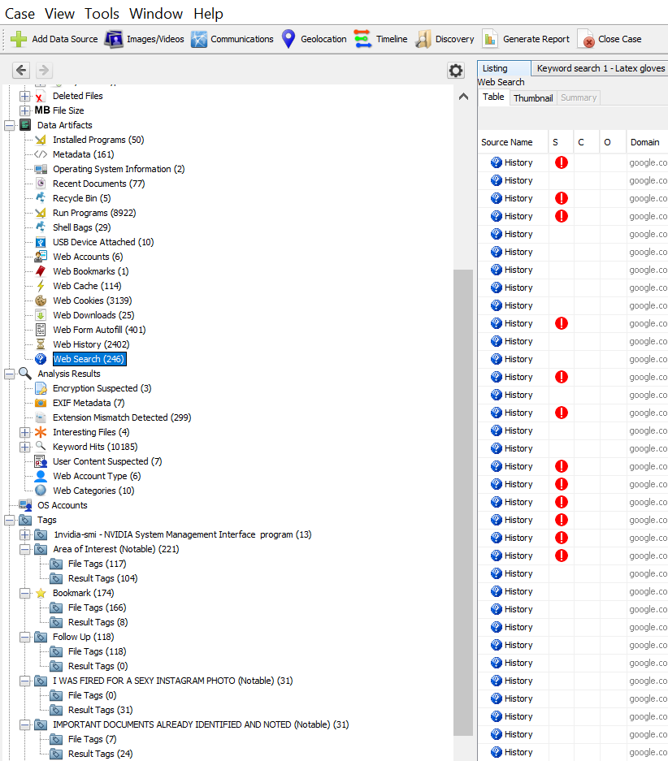

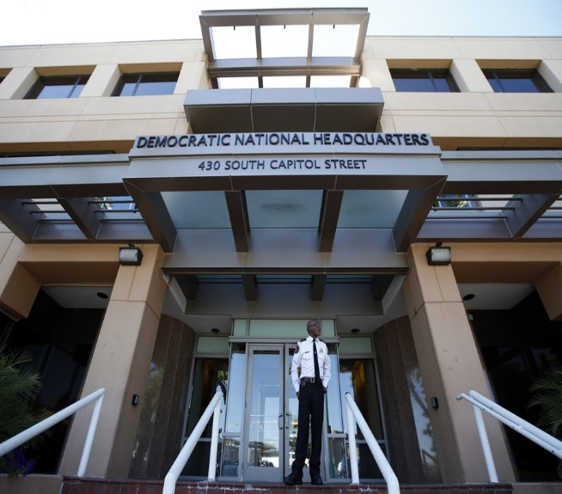
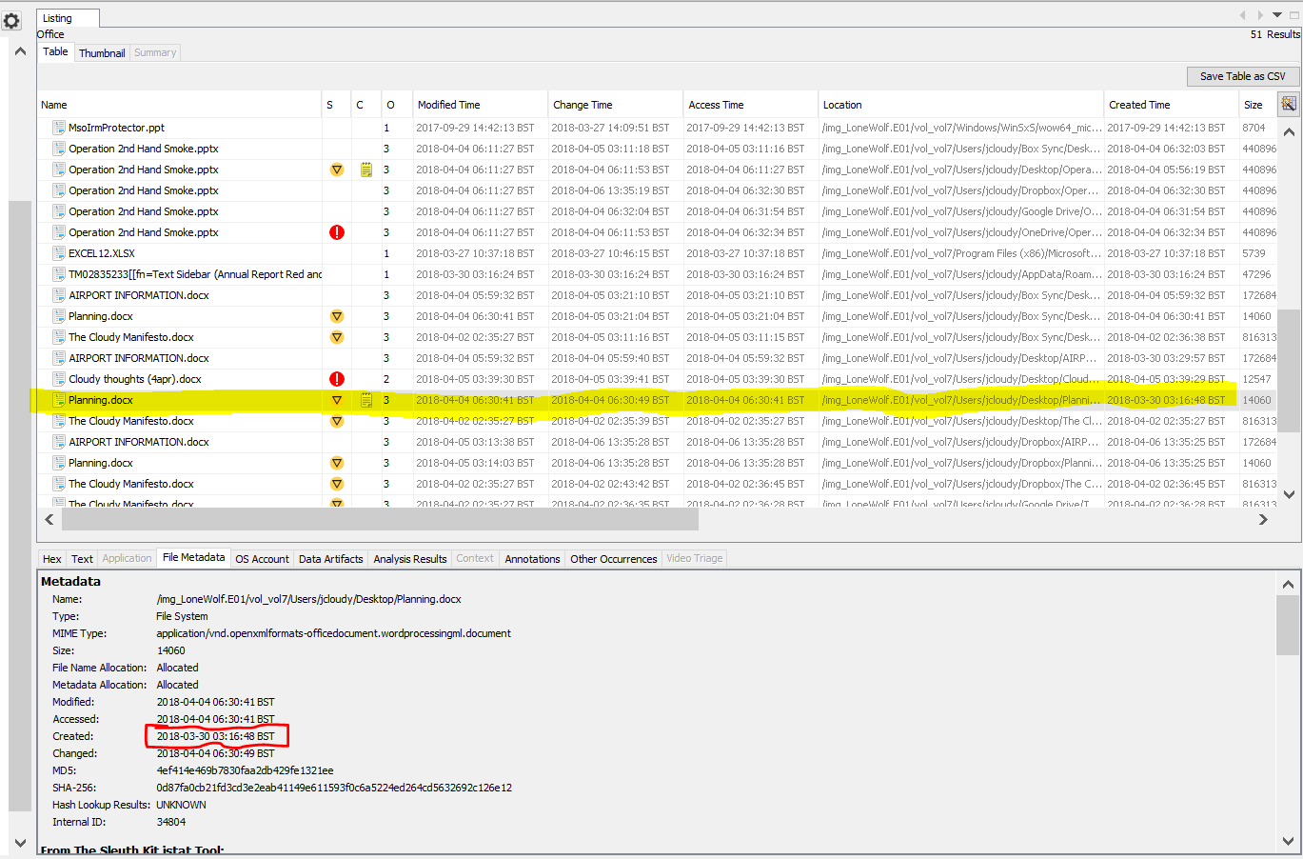
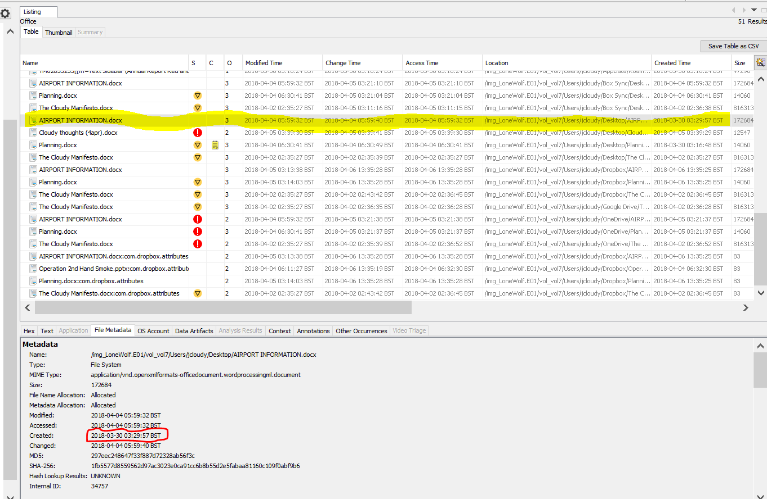
Presenting the Evidence: MDX/E2&E3 CONTD.

Slide 13
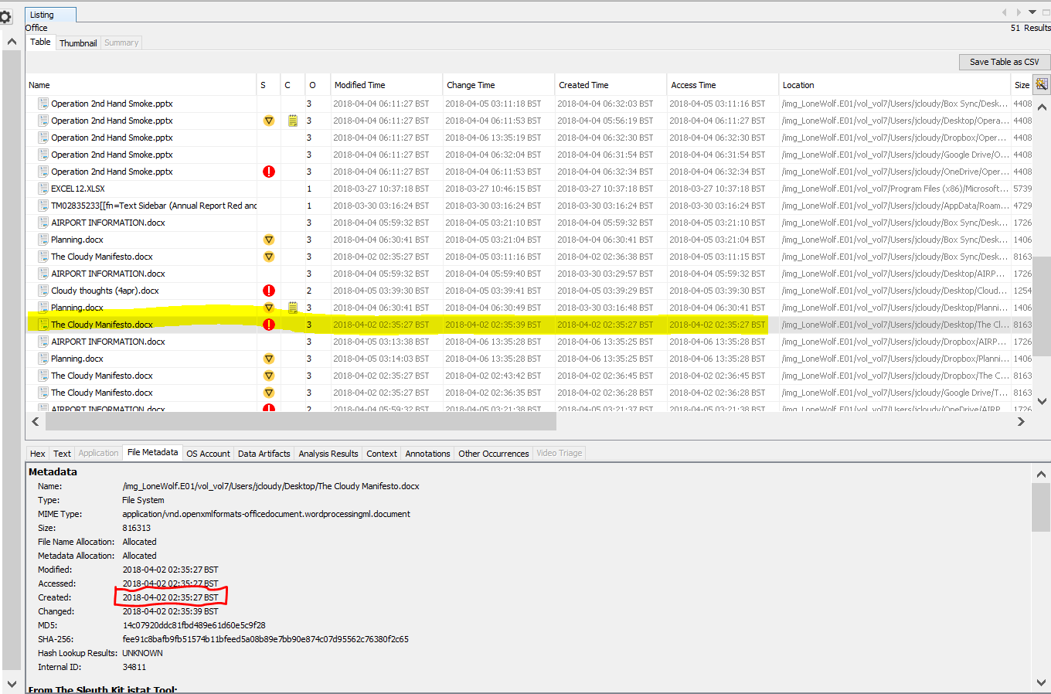
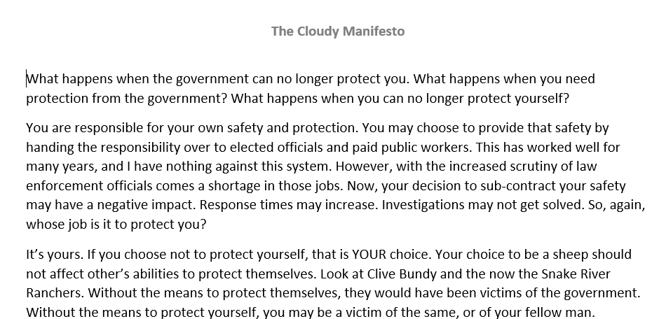
THE CLOUDY MANIFESTO Time: 02:35:27 BST Date: 02/04/2018
Prominent images, websites, notes and write ups were read, visited and downloaded between 31/3/18 and 02/04/2018.
Questions while you should protect yourself.
He is frustrated with the hypocrisy of government looking at the statistics of what kills American.
Supports for self-protection,
(Attachments for exhibit MDX/E4).

Slide 14
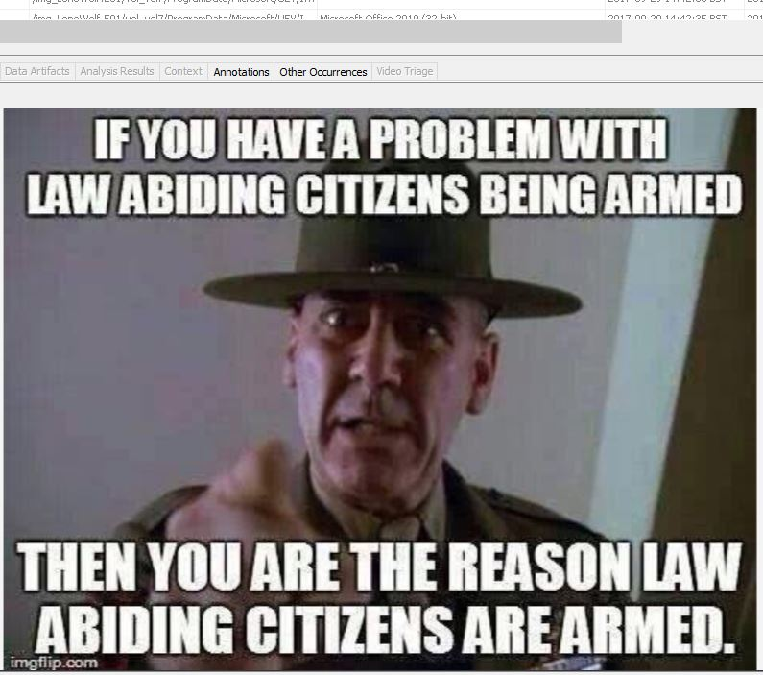
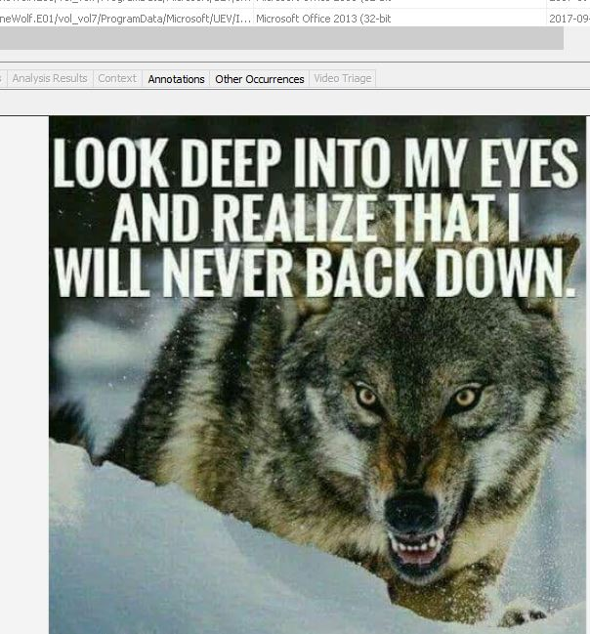
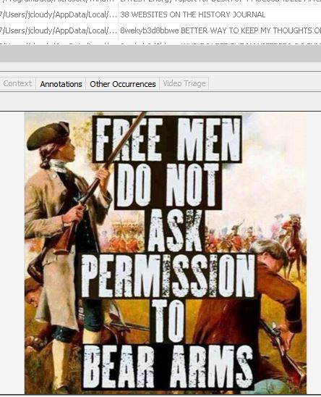
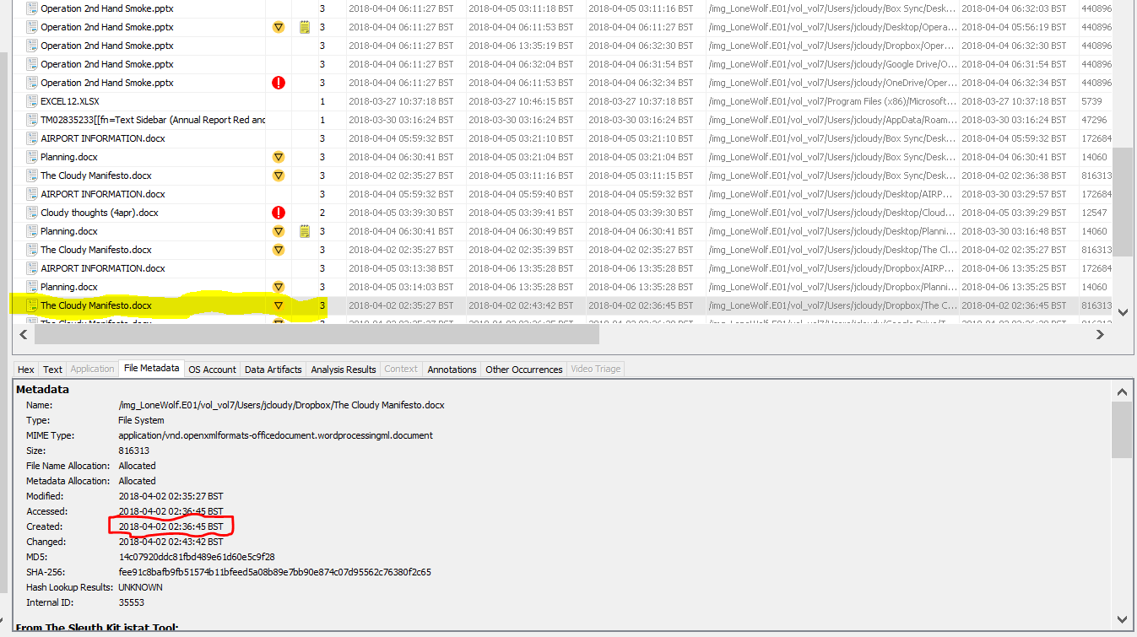
THE CLOUDY MANIFESTO EXHIBIT MDX/E4 CONTD

Slide 15
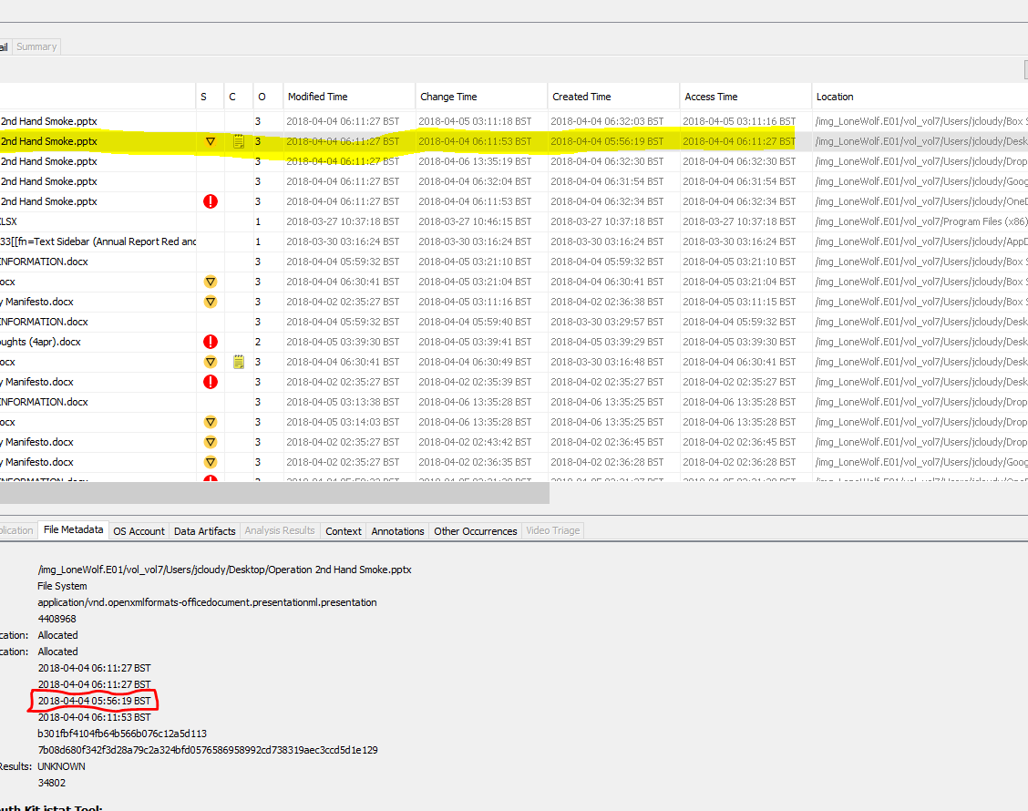

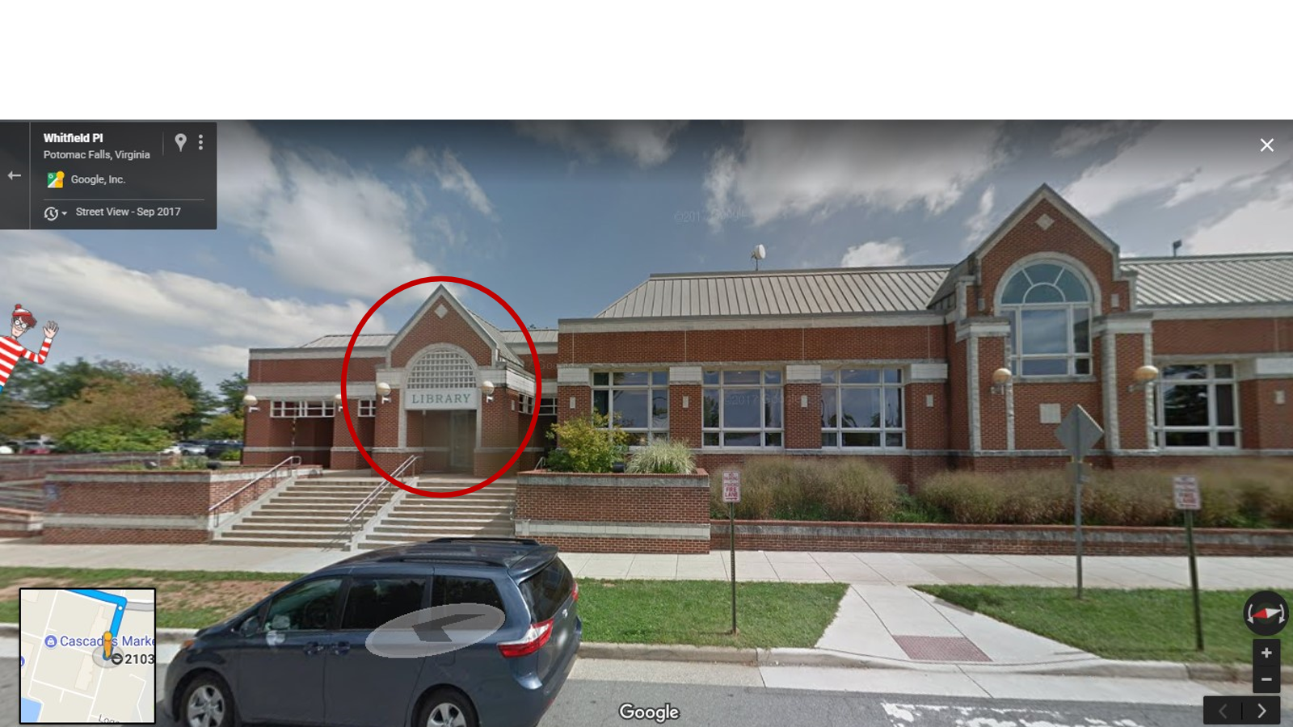
OPERATION 2ND HAND SMOKE Time: 05:56:19 BST Date: 04/04/2018 EXHIBIT MDX/E5
Gun violence meeting.
Cascade Library B
Google map from 21030 Whitefied to IAD Airport
Flight reservation for 07/04/2018
Hotel reservation for 08/04 to 20/04/2018

Slide 16
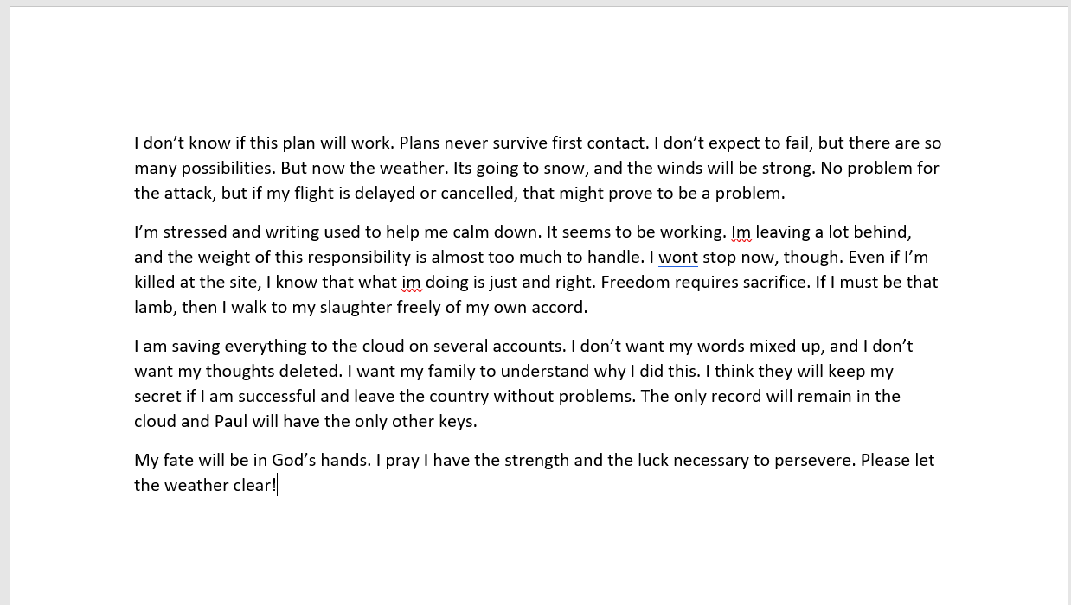
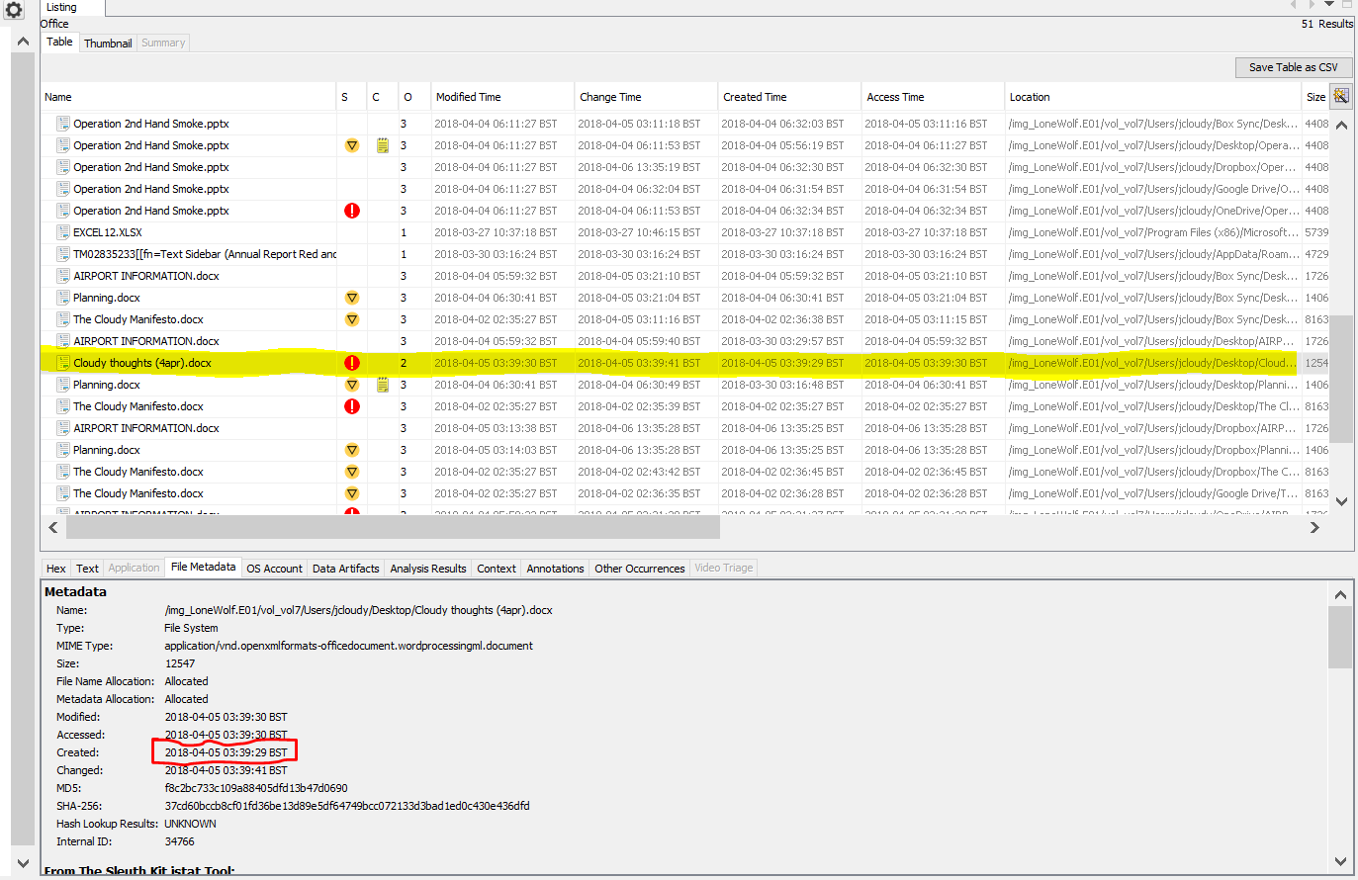
CLOUDY THOUGHTS (4TH) Time: 03:39:29 BST Date: 05/04/2018 TO 06/04/2018
Images, websites, notes and write ups were read, visited and downloaded from 05/04/2018 to 06/04/2018
And Cloudy Thoughts (4th) - current state of mind of the suspect.
Larry king interview on “time to repeal poorly written second amendment”.
is it legal to carry large sums of cash out of the country?
Can I strap cash to myself and walk-through TSA? Etc. (Attachments for Exhibit MDX/E6).

Slide 17
SUMMARY OF FINDINGS AND CONCLUSION
Does the suspect have any intention and confession to commit the offence?
Cloudy thoughts and manisfesto docs.
Does the suspect have any documented plan to commit the offence?
None of the available documents could proof this.
Does the suspect have plan to be at 21030 Whitfield Pl Sterling VA on 7th of April?
Only a google map supported this which may not be true.
Does he have plan to travel out of the country on the same day?
Only travel itinerary available and no confirmed ticket.
Who else is aware of this plan?
We have a name called Paul but no other details to confirm the exact information.
In conclusion, there is need for further investigation on this case because all the available exhibits and information are just intention.

Slide 18


FUTURE RESEARCH OPPORTUNITIES
Two flash drives used on 27/03/2018
Who is Paul?
Did he pay for the ticket and hotel?
Who is behind the brother’s chat (292) from the web history and what is the content?

Slide 19

Lonewolf’s Investigation Case
These images are now produced on CD-R as exhibit MDX/E7. This disc is encrypted using one of the strongest encryption methods currently available, ROT13.

Slide 20
References
2021 Guidelines Manual Annotated (2021) United States Sentencing Commission. Available at: https://www.ussc.gov/guidelines/2021-guidelines-manual-annotated (Accessed: December 3, 2022).
Participation, E. (1990) Computer misuse act 1990, Legislation.gov.uk. Statute Law Database. Available at: https://www.legislation.gov.uk/ukpga/1990/18/contents (Accessed: December 3, 2022).
Participation, E. (no date) Police and justice act 2006, Legislation.gov.uk. Statute Law Database. Available at: https://www.legislation.gov.uk/ukpga/2006/48/contents (Accessed: December 3, 2022).
Lallie, H. and Pimlott, L., 2012. Applying the ACPO Principles in Public Cloud Forensic Investigations. Journal of Digital Forensics, Security and Law.
Horsman, G., 2020. ACPO principles for digital evidence: Time for an update? Forensic Science International: Reports, 2, p.100076.
ISO/IEC 27042:2015 (2021) ISO. Available at: https://www.iso.org/standard/44406.html (Accessed: December 3, 2022).
An explanation of ACPO Guidelines for digital based evidence (2022) Athena Forensics. Available at: https://athenaforensics.co.uk/acpo-guidelines-for-computer-forensics/ (Accessed: December 3, 2022).
Garfinkel, S. et al. (no date) 2018 lone wolf scenario, Digital Corpora. Available at: https://digitalcorpora.org/corpora/scenarios/2018-lone-wolf-scenario/ (Accessed: December 3, 2022).

